Slide 1


Manipulating the Squeezing Properties of a Degenerate Parametric Amplifier with Coherent, Time-Delayed Feedback
Nikolett Német*, Scott Parkins
University of Auckland,
The Dodd-Walls Centre for Photonic and Quantum Technologies
CLEO 10/06/16
*n.nemet@auckland.ac.nz

Slide 2
Outline
Degenerate Parametric Amplifier
Classical dynamics
Quantum treatment below threshold
Squeezing characteristics
DPA with time-delayed coherent feedback
Model
Squeezing spectrum
Change in the dynamics
Effects of loss

Slide 3

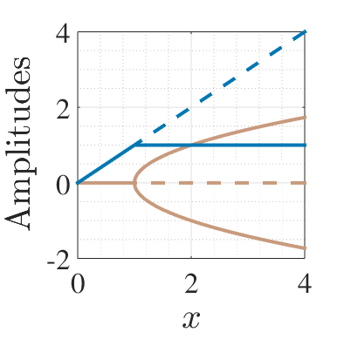
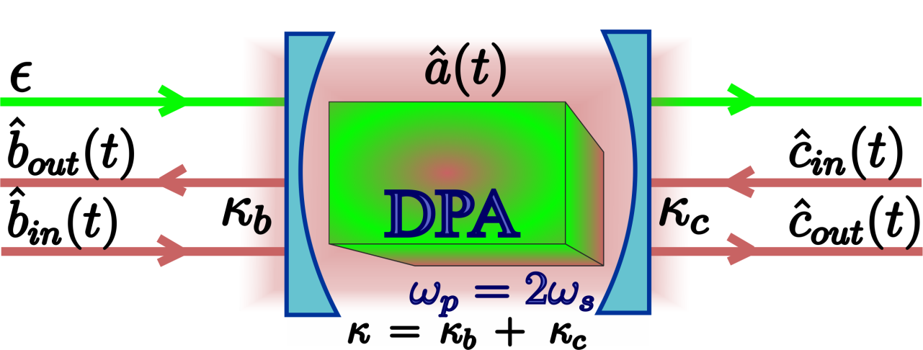

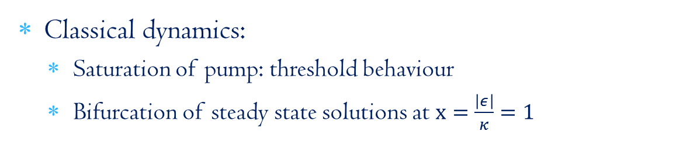
DPA dynamics & squeezing
Classical dynamics:
Saturation of pump: threshold behaviour
Bifurcation of steady state solutions at $x=\frac{\left|ε\right|}{κ}=1$
Quantum mechanical behaviour^{[1]}:
Parametric pump approximation $\left(ε=\left|ε\right|e^{iθ}\right)$
$$\hat{H}=ℏΔ{\hat{a}}^{†}\hat{a}+\frac{1}{2}iℏ\left(ε{\left({\hat{a}}^{†}\right)}^{2}+ε^{∗}{\left(\hat{a}\right)}^{2}\right)$$
^{[1]}PRA, 30:1386 (1984)

Slide 4

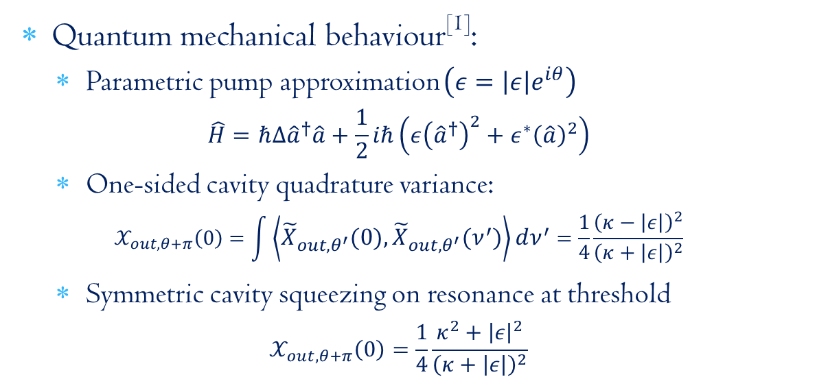
DPA dynamics & squeezing
Classical dynamics:
Saturation of pump: threshold behaviour
Bifurcation of steady state solutions at $x=\frac{\left|ε\right|}{κ}=1$
Quantum mechanical behaviour^{[1]}:
Parametric pump approximation $\left(ε=\left|ε\right|e^{iθ}\right)$
$$\hat{H}=ℏΔ{\hat{a}}^{†}\hat{a}+\frac{1}{2}iℏ\left(ε{\left({\hat{a}}^{†}\right)}^{2}+ε^{∗}{\left(\hat{a}\right)}^{2}\right)$$
One-sided cavity quadrature variance:
$$𝒳_{out,θ+π}\left(0\right)=\int{\left\langle {\tilde{X}}_{out,θ^{′}}\left(0\right),{\tilde{X}}_{out,θ^{′}}\left(ν^{′}\right)\right\rangle dν^{′}}=\frac{1}{4}\frac{{\left(κ−\left|ε\right|\right)}^{2}}{{\left(κ+\left|ε\right|\right)}^{2}}$$
Symmetric cavity squeezing on resonance at threshold
$$𝒳_{out,θ+π}\left(0\right)=\frac{1}{4}\frac{κ^{2}+{\left|ε\right|}^{2}}{{\left(κ+\left|ε\right|\right)}^{2}}$$
^{[1]}PRA, 30:1386 (1984)

Slide 5
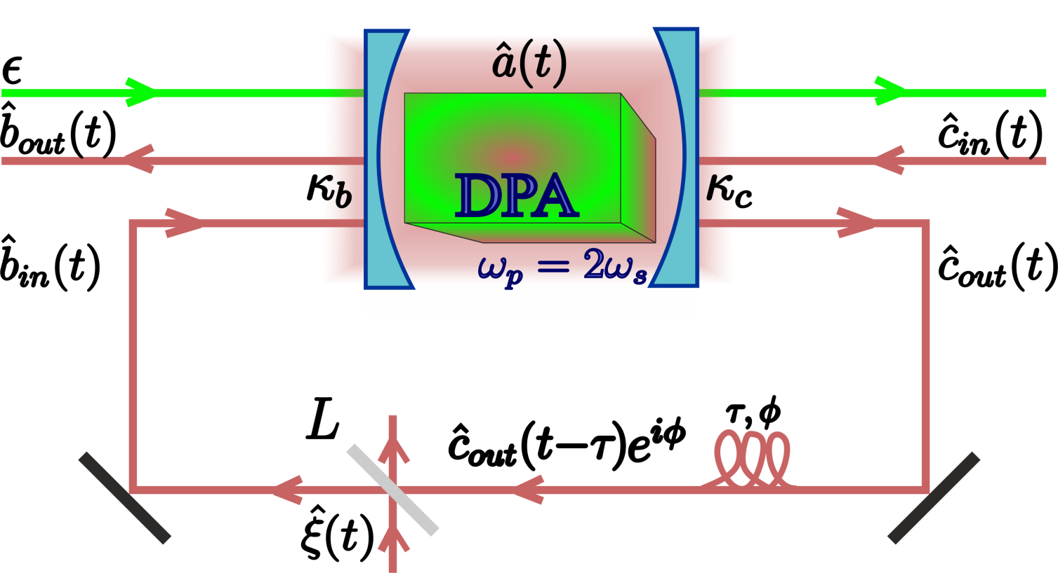
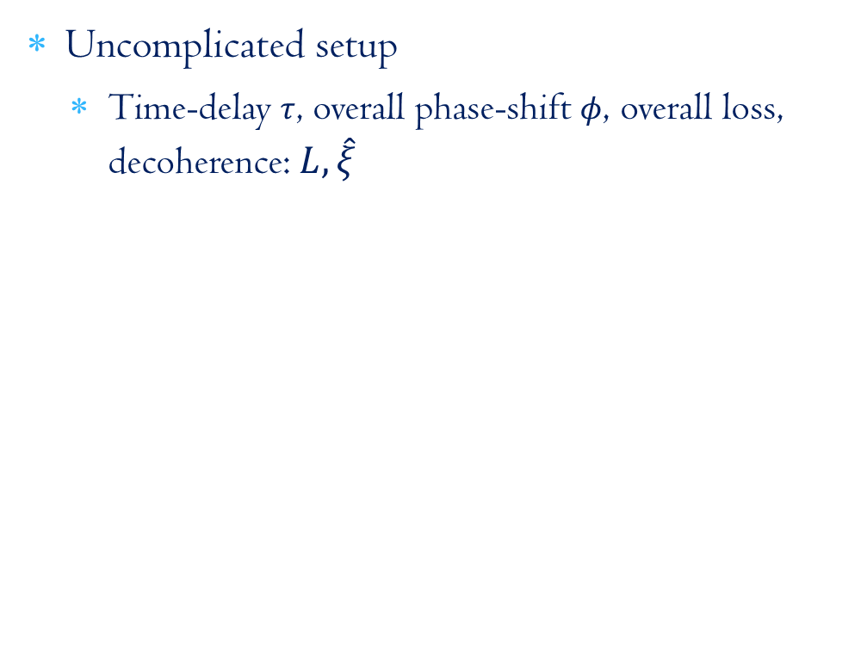
DPA & time-delayed coherent feedback^{[1]}
Uncomplicated setup
Time-delay $τ$, overall phase-shift $φ$, overall loss, decoherence: $L,\hat{ξ}$
^{[1]}arXiv: 1606.00178

Slide 6
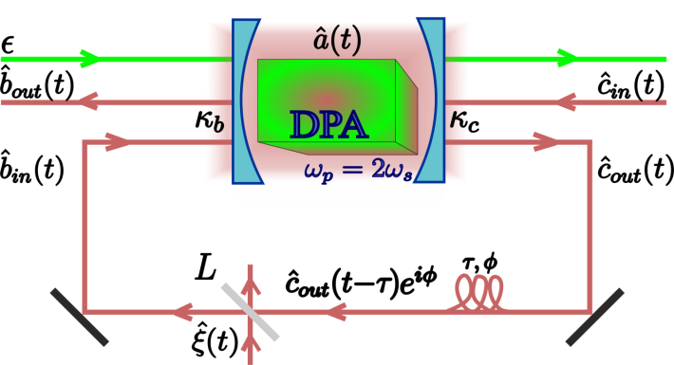
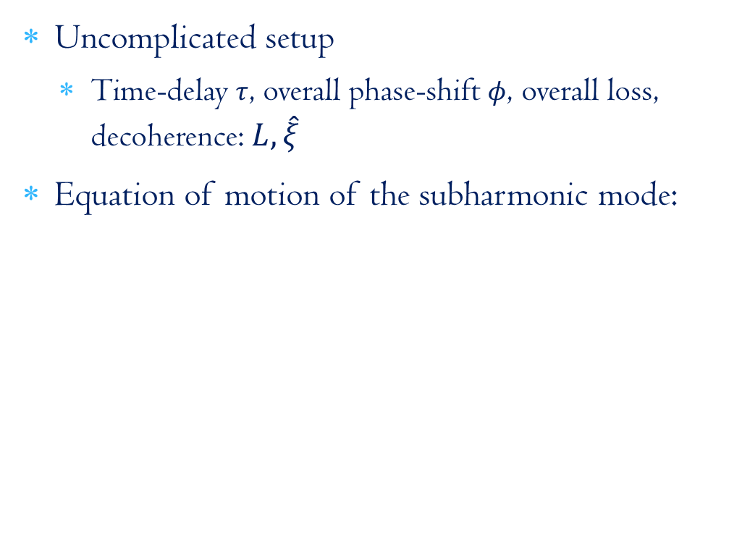
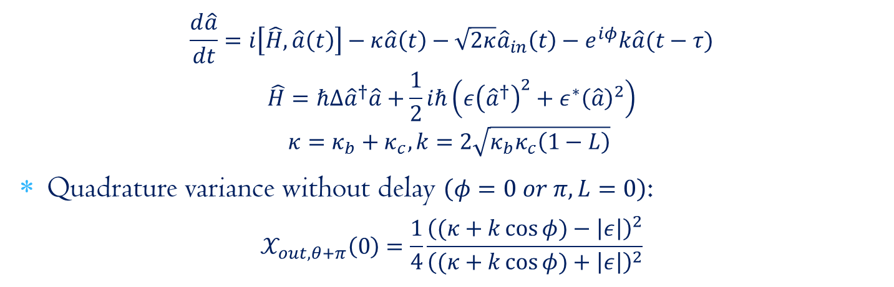
DPA & time-delayed coherent feedback^{[1]}
Uncomplicated setup
Time-delay $τ$, overall phase-shift $φ$, overall loss, decoherence: $L,\hat{ξ}$
Equation of motion of the subharmonic mode:
$$\frac{d\hat{a}}{dt}=i\left[\hat{H},\hat{a}\left(t\right)\right]−κ\hat{a}\left(t\right)−\sqrt{2κ}{\hat{a}}_{in}\left(t\right)−e^{iφ}k\hat{a}(t−τ)$$
$$\hat{H}=ℏΔ{\hat{a}}^{†}\hat{a}+\frac{1}{2}iℏ\left(ε{\left({\hat{a}}^{†}\right)}^{2}+ε^{∗}{\left(\hat{a}\right)}^{2}\right)$$
$$κ=κ_{b}+κ_{c}, k=2\sqrt{κ_{b}κ_{c}\left(1−L\right)}$$
Quadrature variance without delay $\left(φ=0 or π, L=0\right)$:
$$𝒳_{out,θ+π}\left(0\right)=\frac{1}{4}\frac{{\left((κ+k\cos{φ})−\left|ε\right|\right)}^{2}}{{\left((κ+k\cos{φ})+\left|ε\right|\right)}^{2}}$$
^{[1]}arXiv: 1606.00178

Slide 7
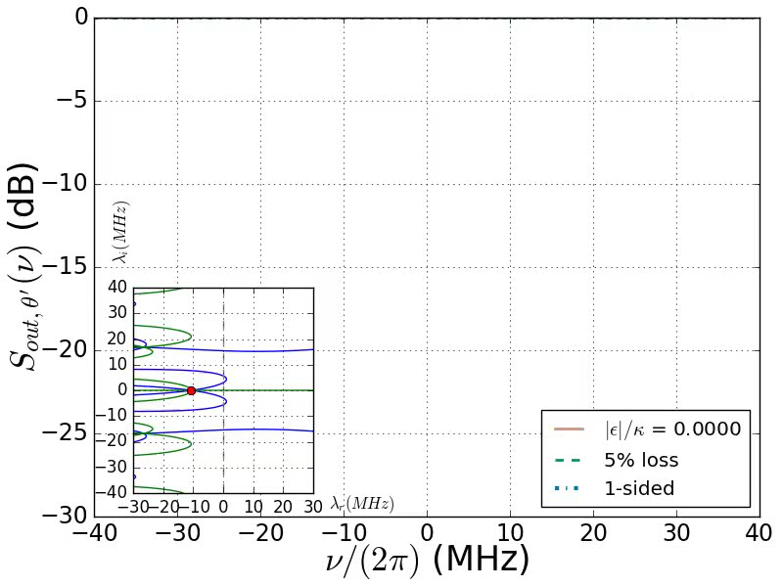

Enhanced squeezing on resonance

Slide 8
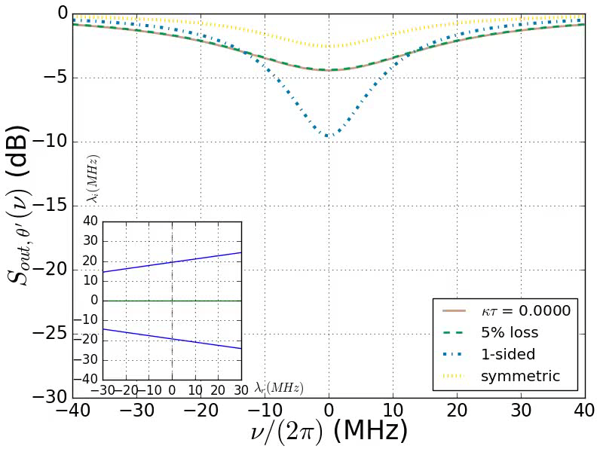
Emerging side-peaks

Slide 9
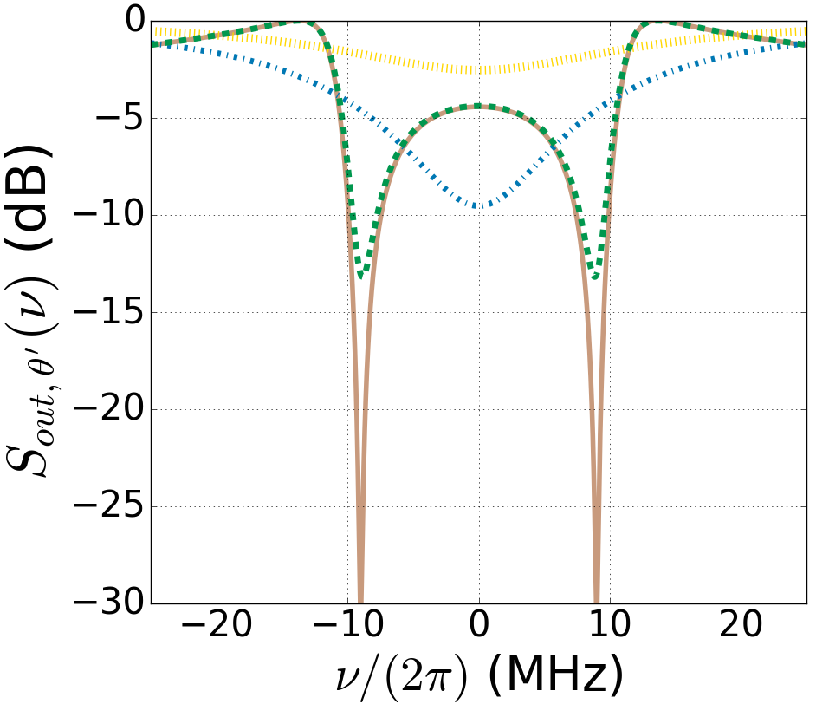
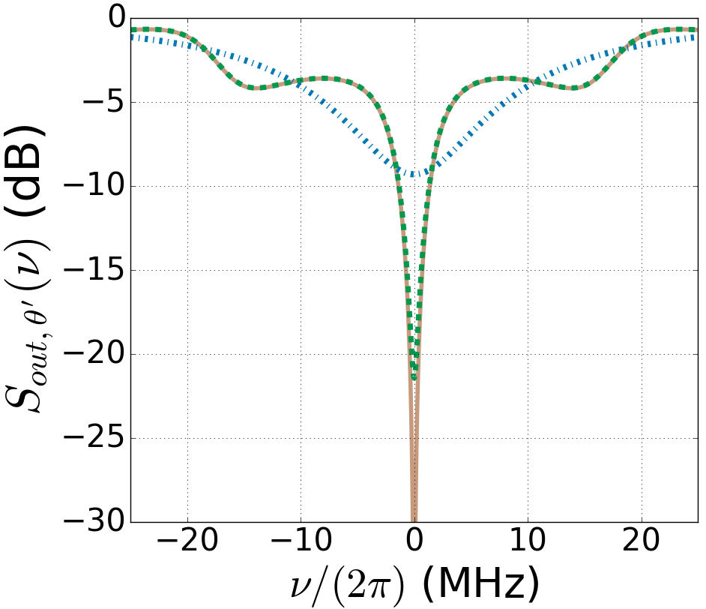
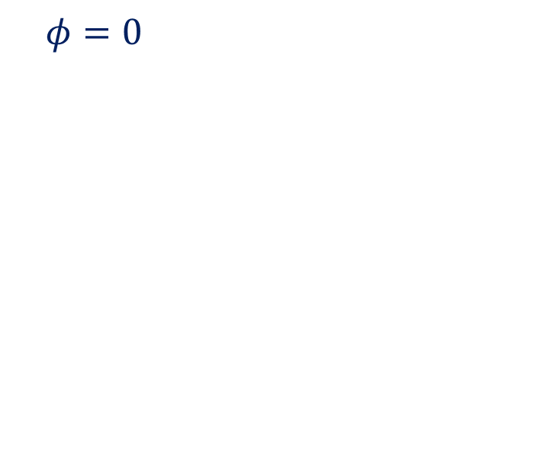
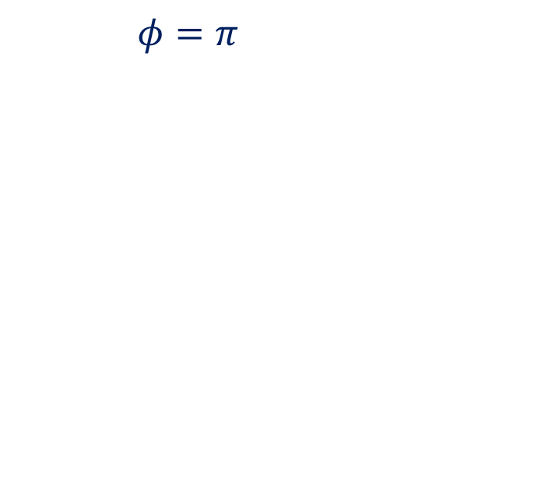


New setup with time-delay
Transcendental equations
Enhanced squeezing with feedback
$φ=0$
$φ=π$
without feedback
symmetric cavity
without feedback
one-sided cavity
with feedback
$$L=5\%$$
with feedback
$$L=0\%$$

Slide 10
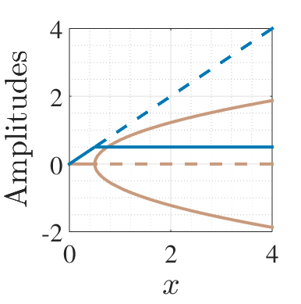
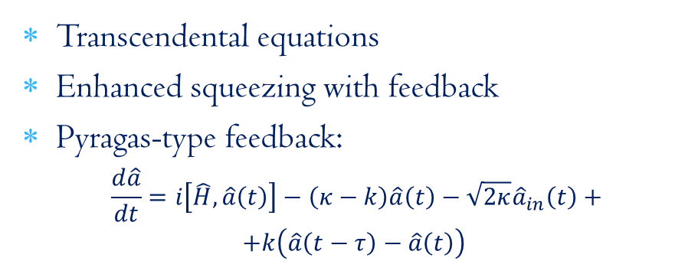

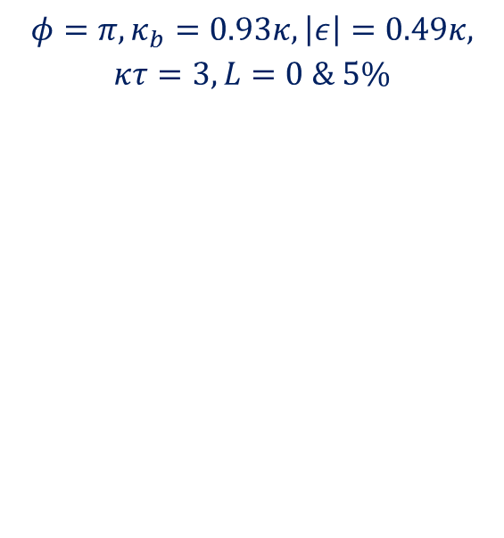

New setup with time-delay
Transcendental equations
Enhanced squeezing with feedback
Pyragas-type feedback:
$$\frac{d\hat{a}}{dt}=i\left[\hat{H},\hat{a}\left(t\right)\right]−\left(κ−k\right)\hat{a}\left(t\right)−\sqrt{2κ}{\hat{a}}_{in}\left(t\right)+$$
$$+k\left(\hat{a}\left(t−τ\right)−\hat{a}\left(t\right)\right)$$
$$φ=π,κ_{b}=0.93κ,\left|ε\right|=0.49κ,$$
$$κτ=3,L=0 \& 5\%$$
$$k=κ/2, φ=π$$
$$k=0, φ=0$$

Slide 11
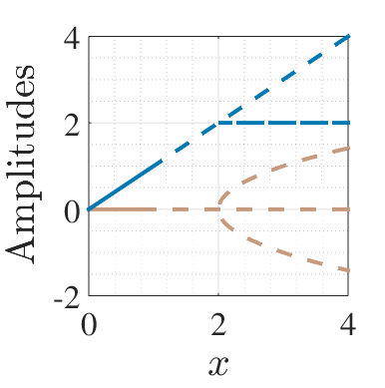
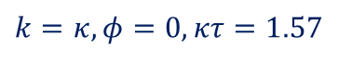
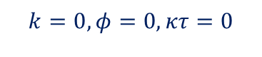
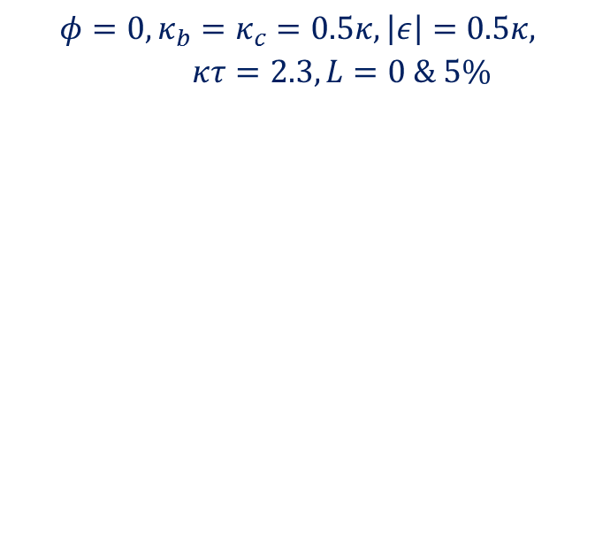
New setup with time-delay
Transcendental equations
Enhanced squeezing with feedback
Limit cycle is reached on threshold
Persistent oscillations with the characteristic frequency
$$φ=0,κ_{b}=κ_{c}=0.5κ, \left|ε\right|=0.5κ, κτ=2.3,L=0 \& 5\%$$
$$k=0, φ=0,κτ=0$$
$$k=κ, φ=0,κτ=1.57$$

Slide 12
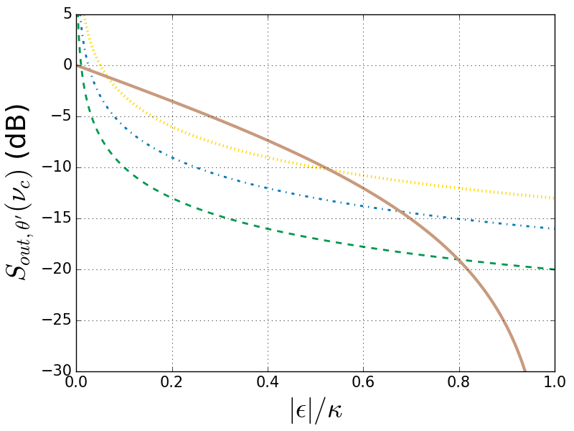
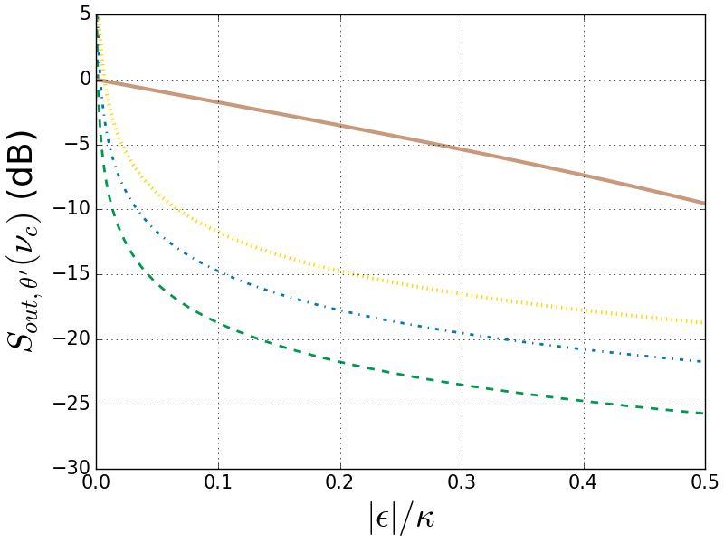
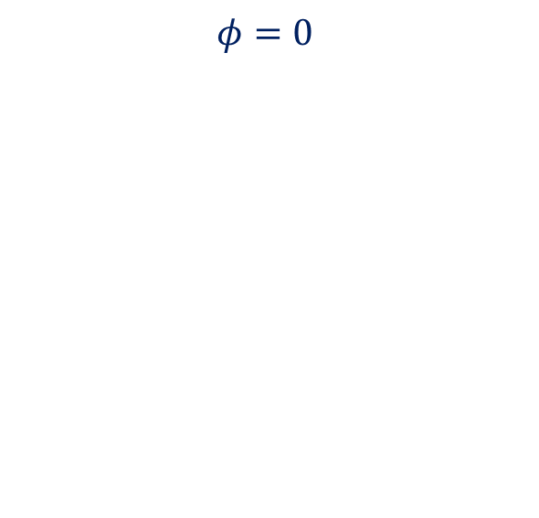
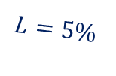
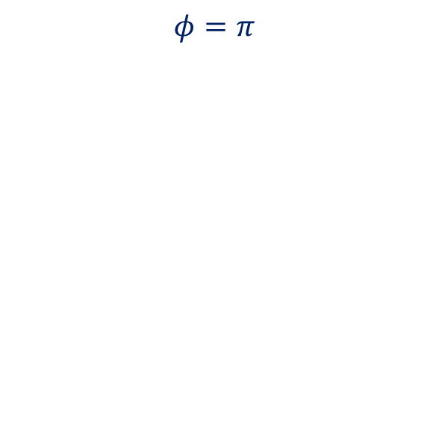
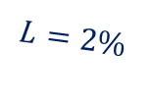

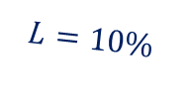

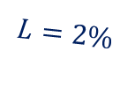
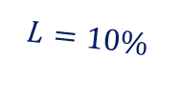
Effects of loss
With loss wider range of tunability
Quadrature variance at the critical point:$𝒳_{out,θ^{′}}\left(ν_{s,Δ}\right)=\frac{1}{4}\frac{Lκ_{c}}{\left|ε_{Δ}\right|}$
$$φ=0$$
$$φ=π$$
one-sided without feedback
one-sided without feedback
$$L=10\%$$
$$L=5\%$$
$$L=10\%$$
$$L=2\%$$
$$L=5\%$$
$$L=2\%$$

Slide 13
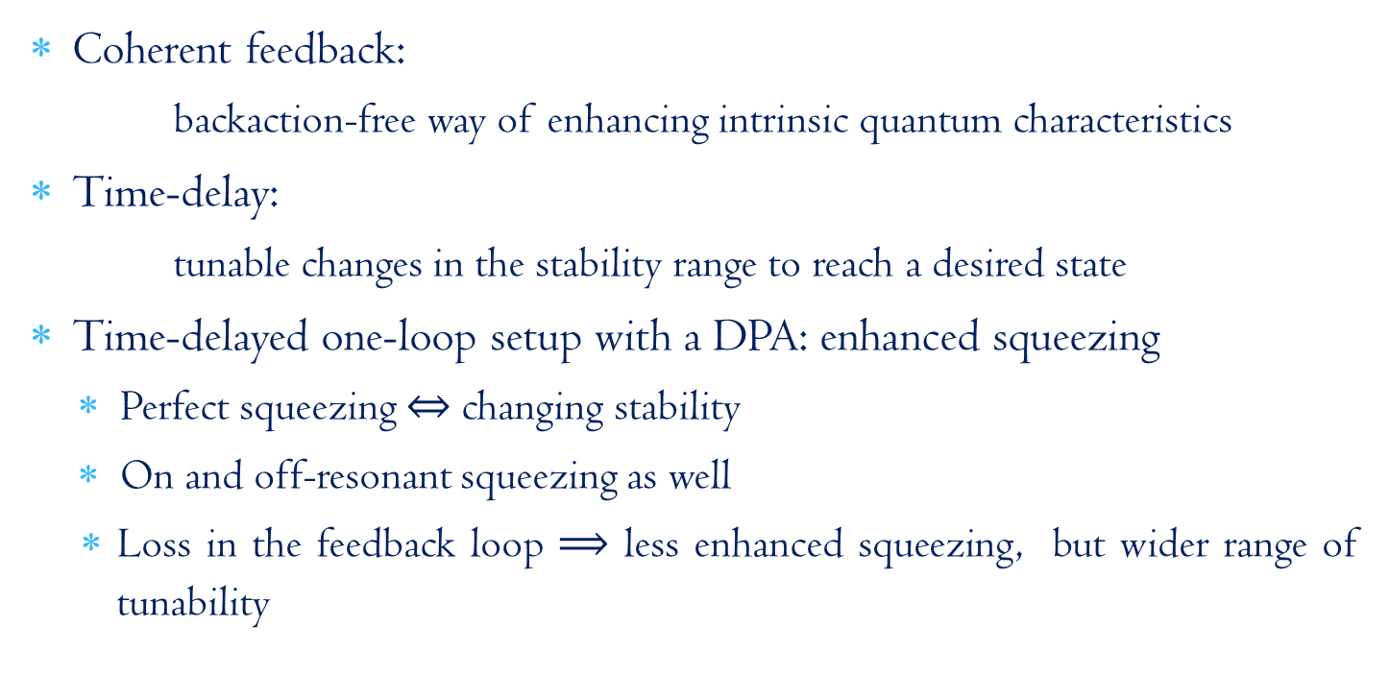
Summary
Coherent feedback:
backaction-free way of enhancing intrinsic quantum characteristics
Time-delay:
tunable changes in the stability range to reach a desired state
Time-delayed one-loop setup with a DPA: enhanced squeezing
Perfect squeezing $⇔$ changing stability
On and off-resonant squeezing as well
Loss in the feedback loop $⟹$ less enhanced squeezing, but wider range of tunability

Slide 14
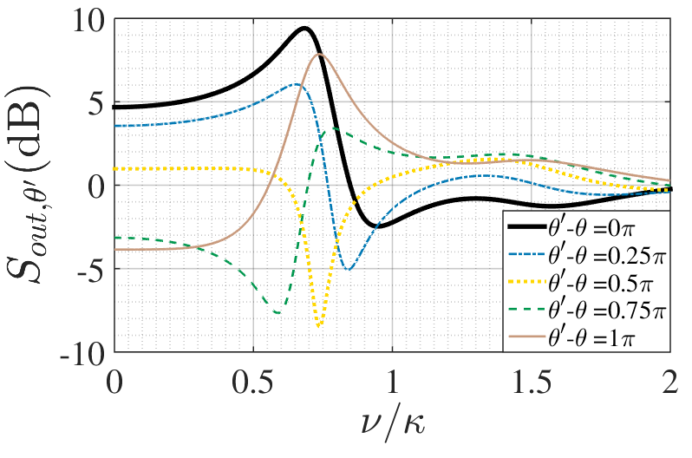

Future plans
Nondegenerate Parametric Amplifier
Measure for EPR-type entanglement: two-mode squeezing
Cavity Optomechanics:
Optomechanical cooling
Storage of optical state in mechanical modes
Nonlinear regime
More general setup with DPA
Frequency-dependent squeezing
$$\left|ε\right|=0.5κ, κ_{b}=0.3κ,κτ=2,Δ=0,$$
$$φ=−0.3π,L=5\%$$

Slide 15
Thank you for your
attention!

Slide 16
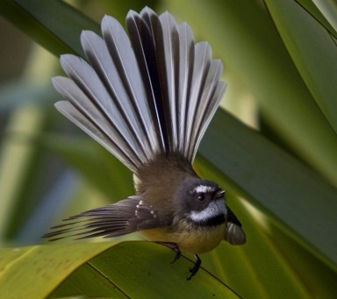
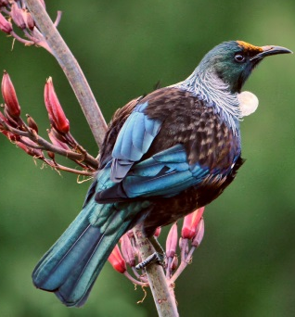

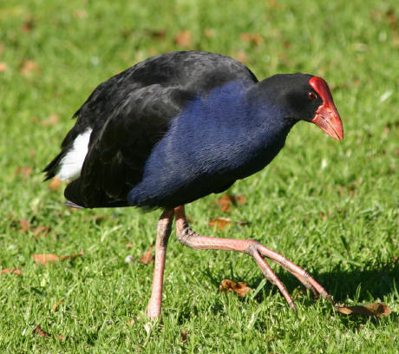

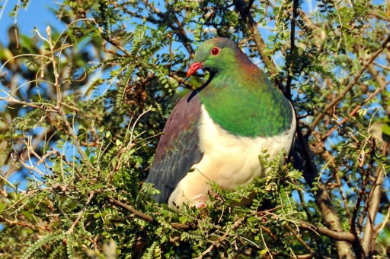
Thank you for your
1
2
3
4
5
6
7
8
9
attention!

Slide 17
Useful References
Coherent feedback:
Seth Lloyd’s group, PRA 62, 022108, PRL 85, 3045 (2000)
John Gough and Matthew James, Commun. Math. Phys. 287, 1109 (2009)
Hideo Mabuchi’s group, PRA 78, 032323 (2008), Opt. Exp. 21, 1 (2013)
Time-delayed feedback:
Kestutis Pyragas, Phys. Lett. A 170, 421 (1992)
Eckehard Schöll’s group, PRE 72, 046203 (2005)
Time-delayed coherent feedback:
Andreas Knorr’s group, PRL 110, 013601 (2013), PRA 92, 053801 (2015)
Arne Grimsmo et al, New J. Phys. 16, 065004 (2014)
Numerical methods for time-delayed feedback with nonlinear systems
Arne Grimsmo, PRL 115, 060402 (2015)
Simon Whalen & Howard Carmichael, (2016), arXiv:1602.03971.
Hannes Pichler and Peter Zoller, PRL 116, 093601 (2016)

Slide 18
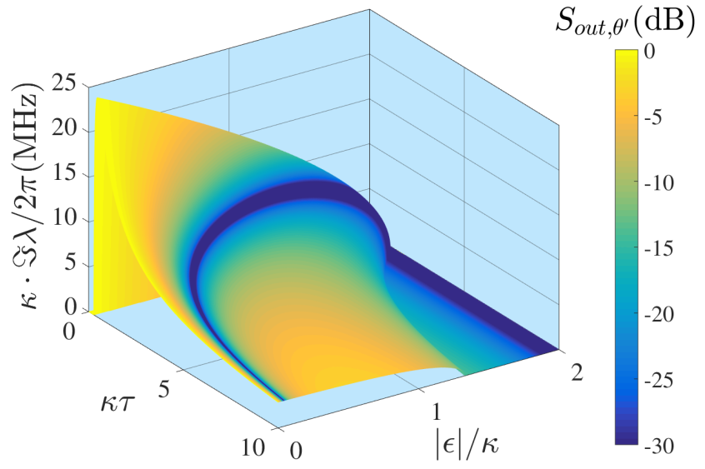
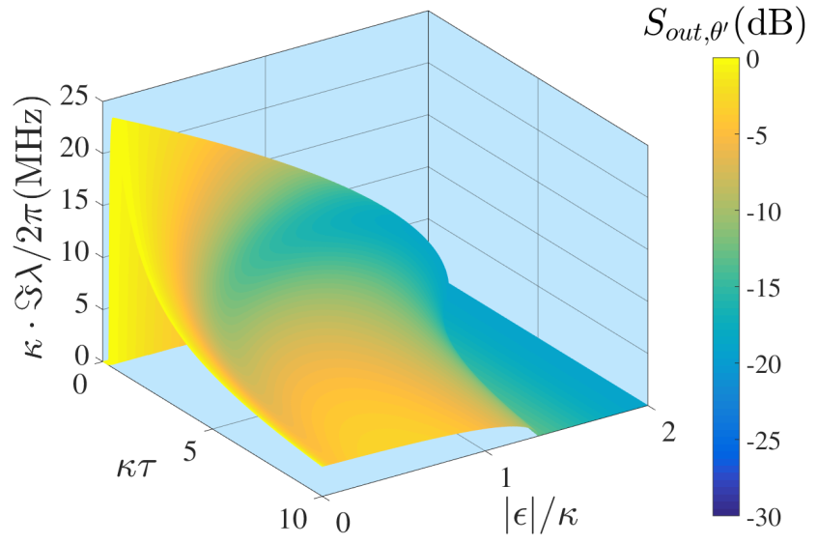
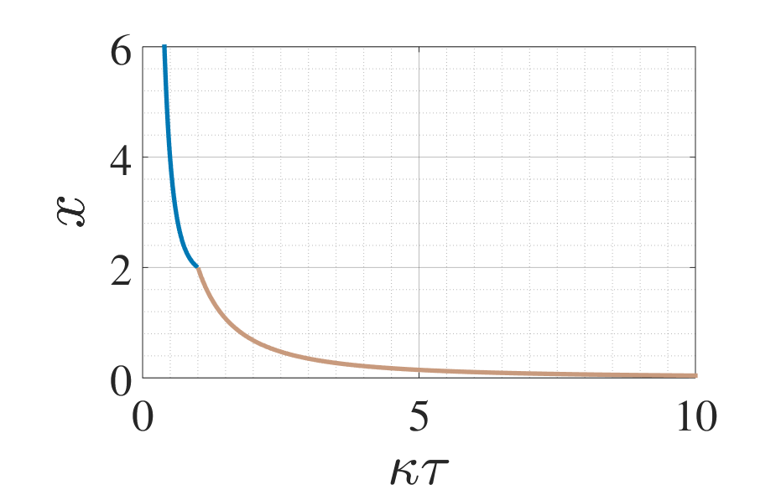
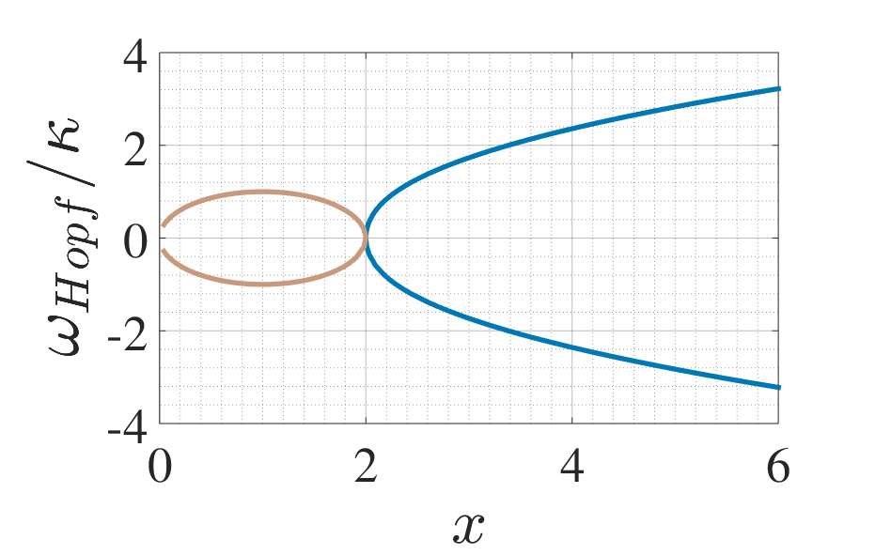
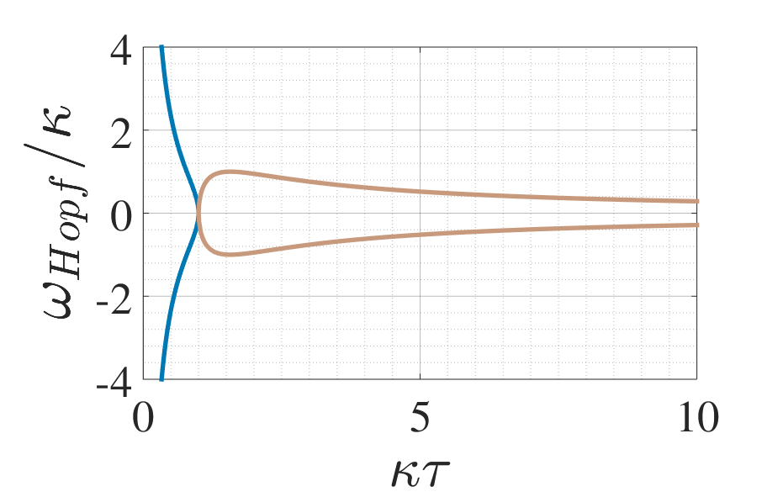
Characteristic frequency range
$$0≤ν_{s}≤\sqrt{\left|ε\right|\left(2κ−\left|ε\right|\right)},0≤\left|ε\right|≤\left|κ+ke^{iφ}\right|$$

Slide 19
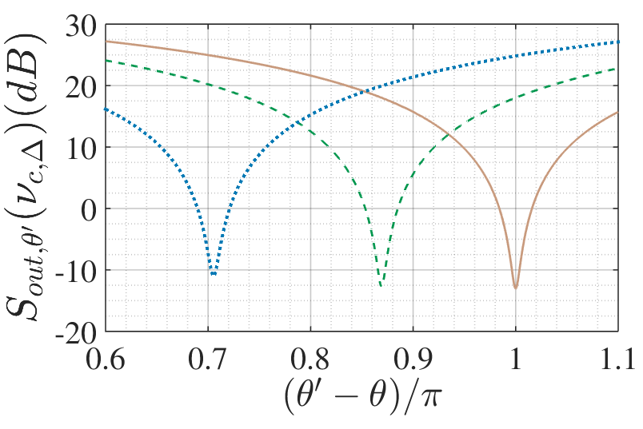
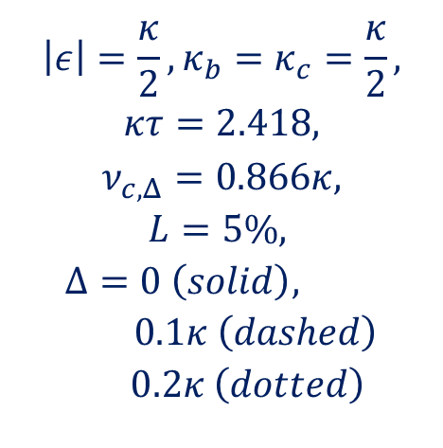

Detuning and quadrature angle
Local oscillator phase:
$$θ^{′}=θ−π+\arcsin\left(\frac{Δ}{{|ε}_{Δ}|}\right)$$
$$\left|ε\right|=\frac{κ}{2},κ_{b}=κ_{c}=\frac{κ}{2},$$
$$κτ=2.418,$$
$$ν_{c,Δ}=0.866κ,$$
$$L=5\%,$$
$$Δ=0 \left(solid\right), 0.1κ \left(dashed\right)$$
$$0.2κ \left(dotted\right)$$

Slide 20
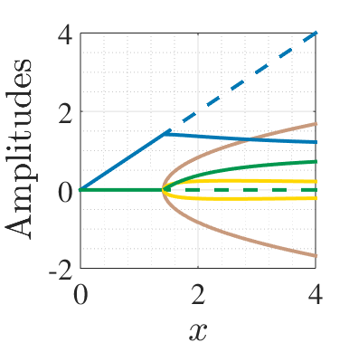
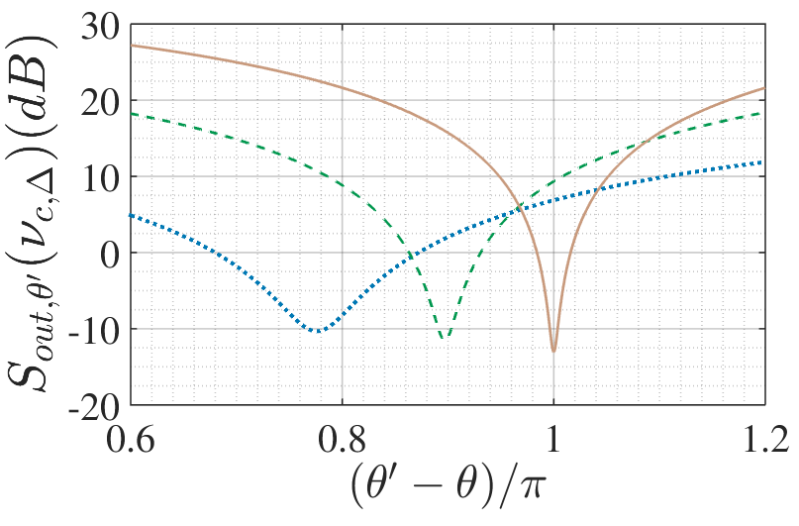
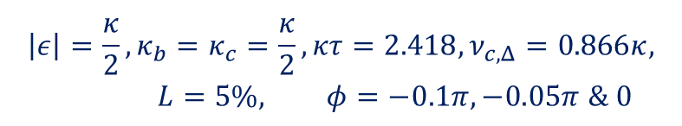
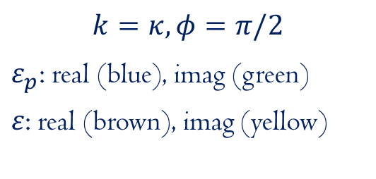
Effects of the phase shift
$$\left|ε\right|=\frac{κ}{2},κ_{b}=κ_{c}=\frac{κ}{2}, κτ=2.418,ν_{c,Δ}=0.866κ, L=5\%, φ=−0.1π, −0.05π \& 0$$
$$k=κ, φ=π/2$$
$ε_{p}$: real (blue), imag (green)
$ε$: real (brown), imag (yellow)

Slide 21
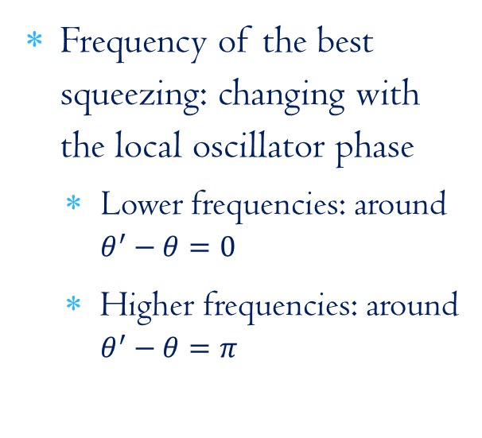

Gravitational waves
Adding $π$ to the local oscillator phase in our case gives the required characteristics
Frequency of the best squeezing: changing with the local oscillator phase
Lower frequencies: around $θ^{′}−θ=0$
Higher frequencies: around $θ^{′}−θ=π$
^{[1]}PLA, 170:421 (1992), ^{[2]}NJP 16:065004 (2014),

Slide 22
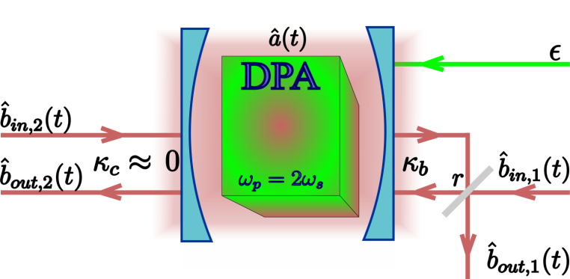


Coherent feedback with DPA
Single DPA
Feedback via beam splitter^{[1]}
Enhanced, tunable squeezing at a given driving strength
$𝒳_{out,θ+π}\left(0\right)=\frac{1}{4}\frac{{\left(κ(r)−\left|ε\right|\right)}^{2}}{{\left(κ(r)+\left|ε\right|\right)}^{2}}$
Modified threshold
Experiment^{[2]} agrees with theory^{[1]}
BUT! Performance is limited
efficient $\left|ε\right|$ range under $0.6κ$
losses through the „perfectly reflecting mirror”
^{[1]}PRA, 80:042107 (2009), ^{[2]}IEEE Trans. Auto. Contr., 57:2045 (2012)

Slide 23

Comparison with previous results^{[1,2]}
with BS
feedback^{[2]}
without
feedback^{[1]}
with delayed feedback
^{[1]}PRA, 30:1386 (1984), ^{[2]}IEEE Trans. Auto. Contr., 57:2045 (2012)

Slide 24

Comparison with previous results^{[1,2]}
with BS
feedback^{[2]}
without
feedback^{[1]}
with delayed feedback
^{[1]}PRA, 30:1386 (1984), ^{[2]}IEEE Trans. Auto. Contr., 57:2045 (2012)

Slide 25


New setup with time-delay
Transcendental equations
Enhanced squeezing with feedback
Properties:
Best squeezing is on resonance
Effects of time-delay:
Narrower spectrum
Emerging small side-peaks
Perfect squeezing at stability change
Condition: $κ−k=\left|ε_{Δ}\right|=\sqrt{{\left|ε\right|}^{2}−Δ^{2}}$
Local phase: $θ^{′}=θ−π+\arcsin\left(\frac{Δ}{{|ε}_{Δ}|}\right)$
Variance: $𝒳_{out,θ^{′}}\left(ν_{s,Δ}\right)=\frac{1}{4}\frac{Lκ_{c}}{\left|ε_{Δ}\right|}$
$$φ=π,κ_{b}=0.93κ,\left|ε\right|=0.49κ,$$
$$κτ=3,L=0 \& 5\%$$

Slide 26


New setup with time-delay
Transcendental equations
Enhanced squeezing with feedback
$$φ=0,κ_{b}=κ_{c}=0.5κ, \left|ε\right|=0.5κ, κτ=2.3,L=0 \& 5\%$$
Properties:
Best squeezing is off-resonant
Perfect squeezing at stability change
Local phase: $θ^{′}=θ−π+\arcsin\left(\frac{Δ}{{|ε}_{Δ}|}\right)$
Time-delay: $τ_{s,n,Δ}=\frac{\arccos\left(\frac{\left|ε_{Δ}\right|−κ}{k}\right)+2nπ}{ν_{s,Δ}}$
Frequency: $ν_{s,Δ}=±\sqrt{k^{2}−{\left(\left|ε_{Δ}\right|−κ\right)}^{2}}$
Variance: $𝒳_{out,θ^{′}}\left(ν_{s,Δ}\right)=\frac{1}{4}\frac{Lκ_{c}}{\left|ε_{Δ}\right|}$

Slide 27



Classical analysis
Originally: pitchfork bifurcation
Time-delay: Changing stability of steady state solutions
Hopf bifurcation
Imaginary eigenvalue becomes the frequency of persistent oscillations
$$\left|ε\right|=0.745κ,κτ=1.8833$$
$$\left|ε\right|=0.78κ,κτ=1.8833$$

